Slide 1
Software Analysis and Design: What it is and why?
WIA2006

Slide 2
The Reality of Software: Jenga & Urban Archaeology
If you have ever worked with existing software, you know legacy code is like urban archaeology. You are excavating an ancient city built on top of older ancient cities. You find mysterious pipes under the street that no living person has a map of. Cutting one pipe might accidentally turn off water for three city blocks.
Bug Fixing in Complex Code is like Jenga. You pull out one tiny block near the bottom because it looked loose, only to watch three completely unrelated systems at the top wobble and collapse.
System Analysis and Design is the discipline that prevents your software from turning into a fragile game of Jenga or an unmapped archaeological mess.

Slide 3
System Analysis and Design (SAD)
SAD bridges the messy, real-world problems of humans with the precise, structured logic of computers.
It provides the blueprint, planning, and architectural foundation of the software world.

Slide 4
Undoubtedly, throughout your degree, you have spent a lot of time learning how to code. However, the ability to code alone does not build complex, reliable software systems.
This course asks you to step back and master two distinct mental gears that must happen before and around the code: System Analysis (Understanding the What) & System Design (Planning the How)

Slide 5
System Analysis (Understanding the What)
  Think of yourself as a master detective or an investigative doctor.
  Before writing a single line of logic, you must diagnose the real problem.
  You interview stakeholders, map existing workflows, identify bottlenecks, and define precise requirements.
  Analysis asks:
    What problem are we actually solving, and what must the software do to solve it?

Slide 6
System Design (Planning the How)
  Now you switch hats to become the architect.
  You design data flow diagrams, database schemas, user interface journeys, and system architectures.
  Design asks:
    How will all these components fit together securely, efficiently, and scalably before we hand the schematics to the developers?

Slide 7
The Blueprint Analogy
Coding without System Analysis and Design is like building a custom home without a blueprint.
You might build a gorgeous, perfectly crafted kitchen only to realize later that you forgot to leave room for the plumbing, or that the front door opens directly into a load-bearing wall.
SAD ensures that every room, pipe, and wire is planned before construction begins.

Slide 8
Throughout this course, you will step beyond being just a coder to become a System Architect:
Requirement Gathering: Learn how to translate vague user complaints ("This app is too slow and frustrating!") into concrete engineering specs.
Visual Modeling: Master industry-standard modeling languages (UML, Data Flow Diagrams, Entity-Relationship Diagrams) to visualize complex systems clearly and cleanly.
SDLC Methodologies: Discover how software moves from initial concept to deployment using system development life cycle (SDLC) models such as Waterfall, Agile, or Scrum.
Feasibility & Risk Analysis: Evaluate whether a proposed system is technically possible, financially viable, and operationally realistic before investing resources.

Slide 9
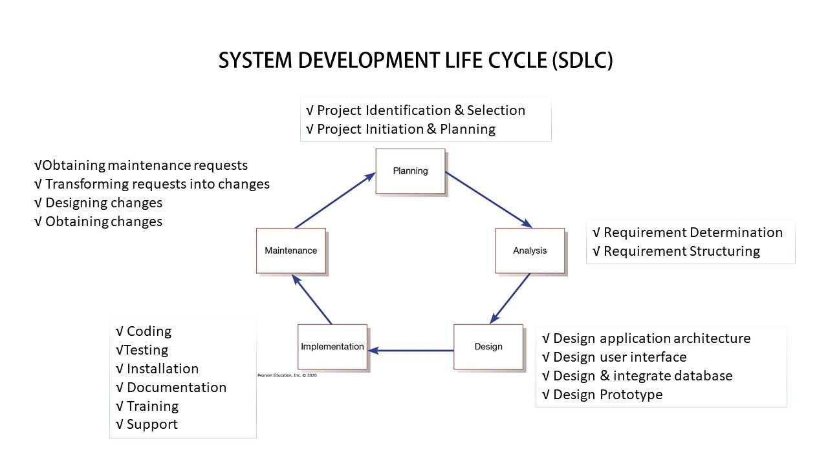

Slide 10
System analysis and design is a step-by-step process for developing high-quality information systems.

Slide 11
Aim to develop a high-quality information system…
An information system (IS) combines technology, people, and data to support business functions such as order processing, inventory control, human resources, and accounting.
People involved in developing IS are managers, users, network administrators, web designers, programmers, and systems analysts.
Information Technology refers to the combination of hardware, software, and services that people use to manage, communicate, and share information.

Slide 12
By the end of this course, you won't just know how to write programs, you’ll know how to design software that scales, survives, and solves real-world problems.

